Slide 1

Hamburgers
Delicious, easy to make and Gordon Ramsey approved!

Slide 2


Slide 3
Index
Lesson Overview
Objectives
Tools Required
Ingredients
Directions
Recap

Slide 4
Lesson Overview
Nothing symbolizes American cooking as much as a Hamburger, and it is actually one of the easiest meal to prepare.
A hamburger, is a sandwich consisting of one or more cooked patties of ground meat, usually beef, placed inside a sliced bread roll or bun. The patty may be pan fried, or flame broiled. Hamburgers are often served with cheese, lettuce, tomato, onion, pickles; condiments such as mustard, mayonnaise, ketchup, relish, and are frequently placed on sesame seed buns.
In this lesson, you will learn how to make a chicken hamburger with the least amount of steps. You will also learn how to prepare the chicken patty for roasting with its juices intact!

Slide 5
Lesson Objectives
At the end of this lesson you'll be able:
To prepare sumptuous chicken patties for your burger
To toast perfect buns for hamburgers
To serve the best hamburgers ever made!

Slide 6



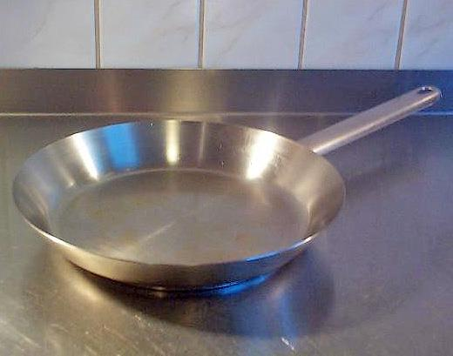
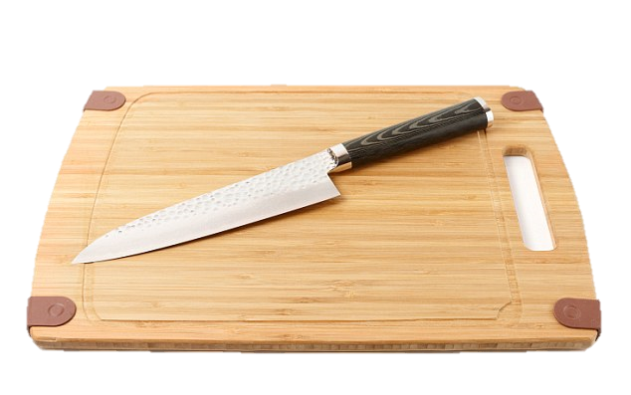
Tool Required
Electric mixer
Chopping Board
Grill Pan
Fry Pan
Spatula
Bowl
Knife

Slide 7
Ingredients
1 kg of chicken
1 large egg
1/2 cup minced onion
1/4 cup fine dried bread crumbs
1 tablespoon Worcestershire
1 or 2 cloves garlic, peeled and minced
About 1/2 teaspoon salt
About 1/4 teaspoon pepper
4 hamburger buns (4 inches wide), split in halves
About 1/4 cup mayonnaise
About 1/4 cup ketchup
4 iceberg lettuce leaves, rinsed and crisped
1 firm-ripe tomato, cored and thinly sliced

Slide 8
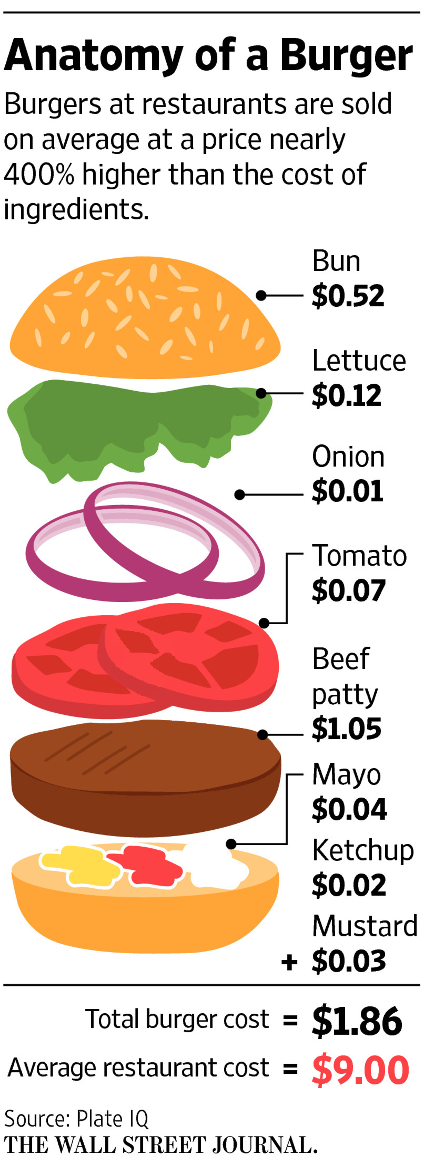
Directions
Preparation : Choose what you want to prepare by clicking on them!
Serving : How to serve the Hamburger preparations

Slide 9
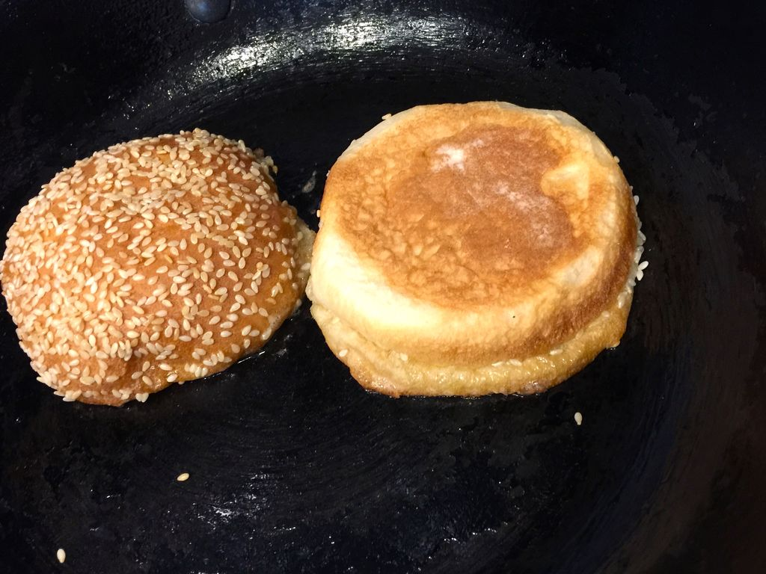
Lay buns, cut side down, on grill and cook until lightly toasted, 30 seconds to 1 minute.
Back to Directions

Slide 10

Foremost!
Grind chicken into ground paste using a mixer.
Next Step : Mix them

Slide 11
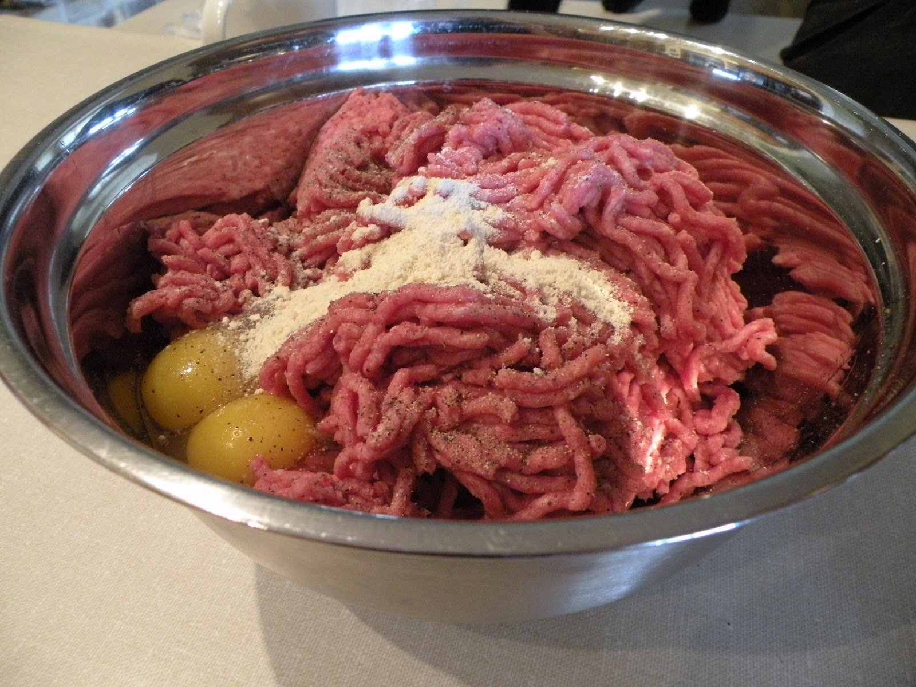
In a bowl, mix:
ground beef,
egg,
onion,
bread crumbs,
Worcestershire sauce,
garlic,
1/2 teaspoon salt, and
1/4 teaspoon pepper until well blended.
Next Step : Make Patty Wedges

Slide 12
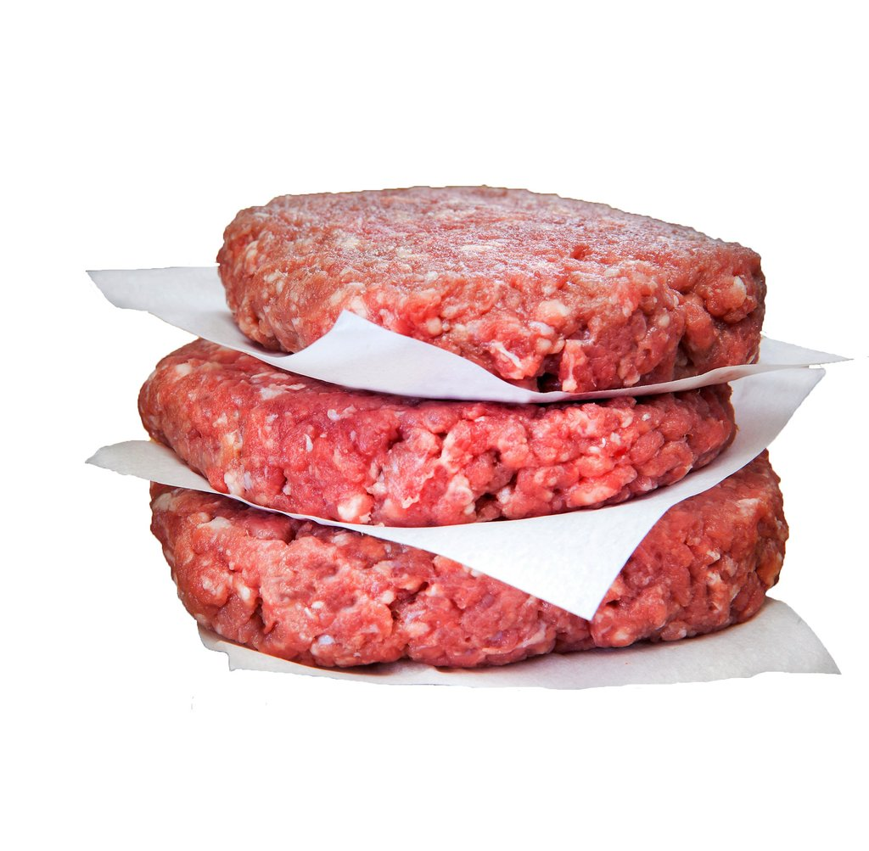
Divide the mixture into equal portions and shape each patty into about 4 inches wide wedges like in the image on left.
You can dig in and use hands or use plastic films to flatten the patties.
Nice and simple!
Next Step : Grill the patties

Slide 13
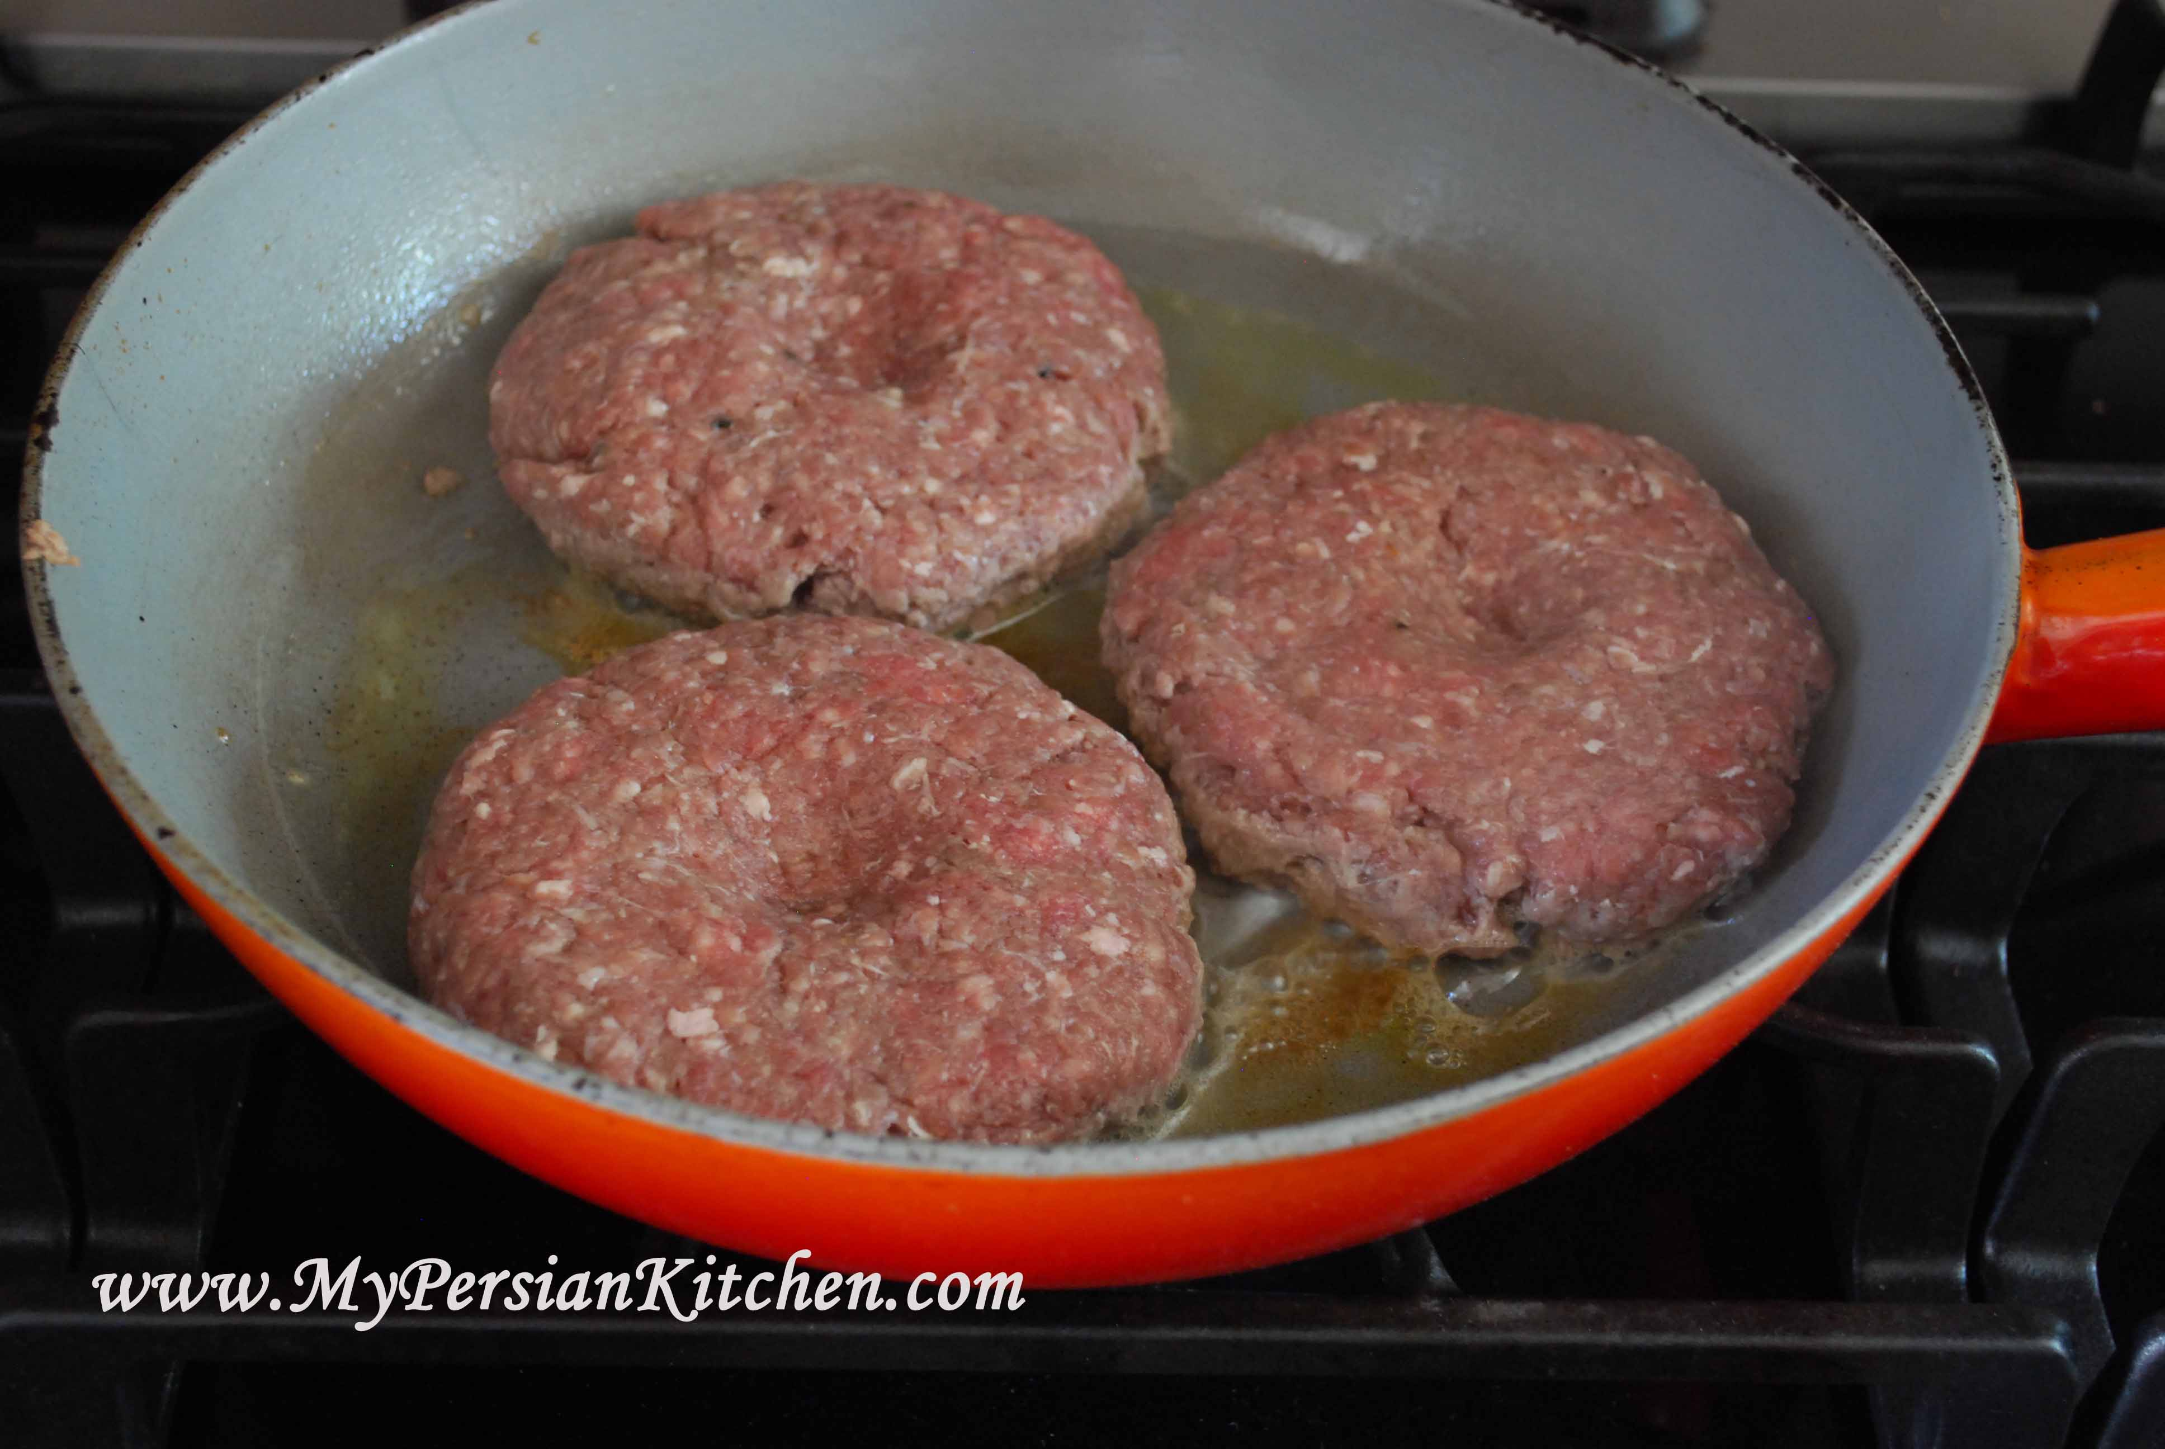
Lay patties on an oiled pan over high heat on a gas stove.
Cook the patties, turning once each side, until browned on both sides and no longer pink inside for 7 to 8 minutes total.
Make small incision to check if the patty is cooked through and through.
Remove from grill.
Back to Directions

Slide 14
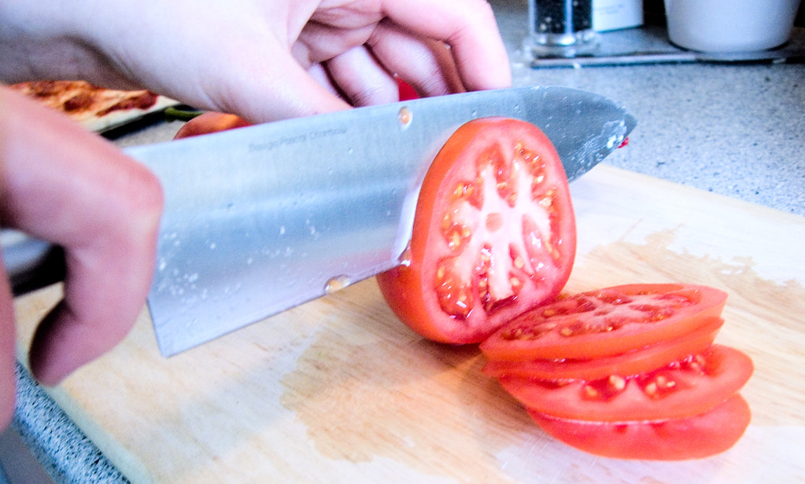
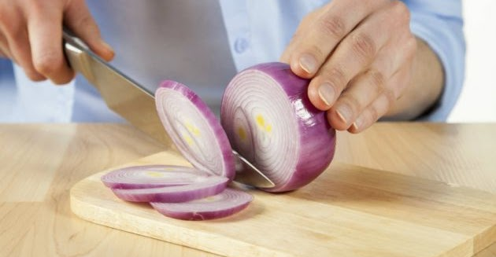
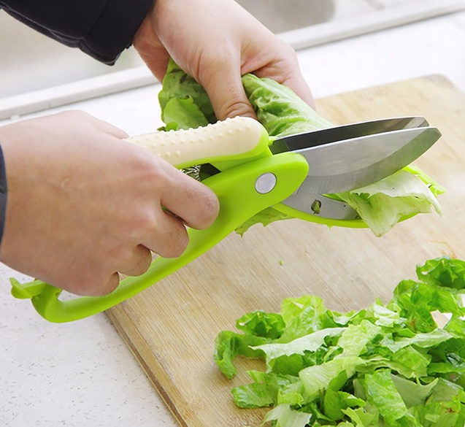
Wash the veggies to be used.
Then thinly slice onion and tomatoes in round salad shape and shred the lettuce leaves.
Back to Directions

Slide 15
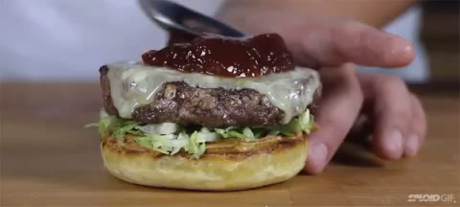
Layer patties, sliced lettuce, tomatoes, onions along with mayonnaise and ketchup in between the toasted buns
Voila!!
Back to Directions

Slide 16
Grinder
Bowl
Grill Pan
Frying Pan
Spatula
1 kg chicken
1 large egg
minced onion
fine dried bread crumbs
Worcestershire
garlic
salt
pepper
4 hamburger buns (4 in. wide), split
mayonnaise
ketchup
4 iceberg lettuce leaves, rinsed and crisped
tomato, cored and thinly sliced
Tools
used
Ingredients

Slide 17
Grind chicken into paste
2. Mix the ground chicken with egg, pepper, spices, sauce
3. Shape the meat mix into round wedges and fry them golden brown
4. Lightly fry the buns
5. Layer patties, sliced lettuce, tomatoes, onions along with mayonnaise and ketchup in between the toasted buns
Voila!!
Nutrition facts
Per Serving:
288 calories; 17.8 g fat; 9.1 g carbohydrates; 21.5 g protein; 96 mg cholesterol; 196 mg sodium
Recipe
Recap

Slide 18
Hamburgers
Are Served!

